Slide 1
Execution of ARM codes – A Simple Demo with KEIL
SHRIRAM K VASUDEVAN

Slide 2
ARM Instruction Set / Thumb Instruction Set.

Slide 3
Conditional Execution
Most instruction sets only allow branches to be executed conditionally.
However by reusing the condition evaluation hardware, ARM effectively increases number of instructions.
All instructions contain a condition field which determines whether the CPU will execute them.
Non-executed instructions soak up 1 cycle.
Still have to complete cycle so as to allow fetching and decoding of following instructions.
This removes the need for many branches, which stall the pipeline (3 cycles to refill).
Allows very dense in-line code, without branches.
The Time penalty of not executing several conditional instructions is frequently less than overhead of the branch or subroutine call that would otherwise be needed.

Slide 4
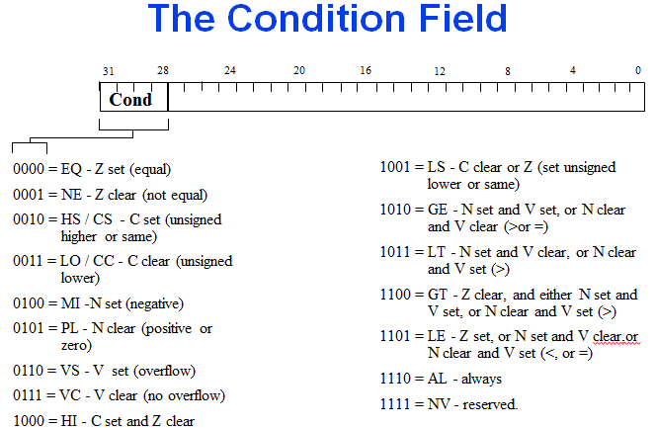
Condition Field.

Slide 5
Conditional Execution
To execute an instruction conditionally, simply postfix it with the appropriate condition:
For example an add instruction takes the form:
ADD r0,r1,r2 ; r0 = r1 + r2 (ADDAL)
To execute this only if the zero flag is set:
ADDEQ r0,r1,r2 ; If zero flag set then… ; ... r0 = r1 + r2
By default, data processing operations do not affect the condition flags (apart from the comparisons where this is the only effect). To cause the condition flags to be updated, the S bit of the instruction needs to be set by postfixing the instruction (and any condition code) with an “S”.
For example to add two numbers and set the condition flags:
ADDS r0,r1,r2 ; r0 = r1 + r2 ; ... and set flags

Slide 6
Quick Analysis of Instruction Set. Data Processing Instructions.
Largest family of ARM instructions, all sharing the same instruction format.
Contains:
Arithmetic operations
Comparisons (no results - just set condition codes)
Logical operations
Data movement between registers
Remember, this is a load / store architecture
These instruction only work on registers, NOT memory.
They each perform a specific operation on one or two operands.
First operand always a register - Rn
Second operand sent to the ALU via barrel shifter.

Slide 7
Arithmetic Instructions.
Operations are:
ADD operand1 + operand2
ADC operand1 + operand2 + carry
SUB operand1 - operand2
SBC operand1 - operand2 + carry -1
RSB operand2 - operand1
RSC operand2 - operand1 + carry - 1
Syntax:
<Operation>{<cond>}{S} Rd, Rn, Operand2
Examples
ADD r0, r1, r2
SUBGT r3, r3, #1
RSB R0, R1, #2; R0 = 2 - R0 will be performed

Slide 8
Comparisons
The only effect of the comparisons is to
UPDATE THE CONDITION FLAGS. Thus no need to set S bit.
Operations are:
CMP operand1 - operand2, but result not written
CMN operand1 + operand2, but result not written
TST operand1 AND operand2, but result not written
TEQ operand1 EOR operand2, but result not written
Syntax:
<Operation>{<cond>} Rn, Operand2
Examples:
CMP r0, r1
TSTEQ r2, #5

Slide 9
Data Movement
Operations are:
MOV operand2
MVN NOT operand2
Note that these make no use of operand1.
Syntax:
<Operation>{<cond>}{S} Rd, Operand2
Examples:
MOV r0, r1
MOVS r2, #10
MVNEQ r1,#0

Slide 10
Multiplication Instructions
The Basic ARM provides two multiplication instructions.
Multiply
MUL{<cond>}{S} Rd, Rm, Rs ; Rd = Rm * Rs
Multiply Accumulate - does addition for free
MLA{<cond>}{S} Rd, Rm, Rs,Rn ; Rd = (Rm * Rs) + Rn
Restrictions on use:
Rd and Rm cannot be the same register
Can be avoid by swapping Rm and Rs around. This works because multiplication is commutative.
Cannot use PC.
These will be picked up by the assembler if overlooked.
Operands can be considered signed or unsigned
Up to user to interpret correctly.

Slide 11
Load Store
The ARM is a Load / Store Architecture:
Does not support memory to memory data processing operations.
Must move data values into registers before using them.
This might sound inefficient, but in practice isn’t:
Load data values from memory into registers.
Process data in registers using a number of data processing instructions which are not slowed down by memory access.
Store results from registers out to memory.
The ARM has three sets of instructions which interact with main memory. These are:
Single register data transfer (LDR / STR).
Block data transfer (LDM/STM).
Single Data Swap (SWP).

Slide 12
Software Support
Download Keil from website. Select ARM core.
It will ask you to register. Register, download and install. It is easy.

Slide 13
Remember this.
There must be an ENTRY directive. This tells the location of the first executable instruction.
AREA defines storage area.
END directive is must to show the code is getting completed there.
ARM can deal directly with 32 bit instructions as you all know.
It is possible to have a halfword by the use of DCW directive. To ensure consistency one should use ALIGN directive as shown in the examples.

Slide 14
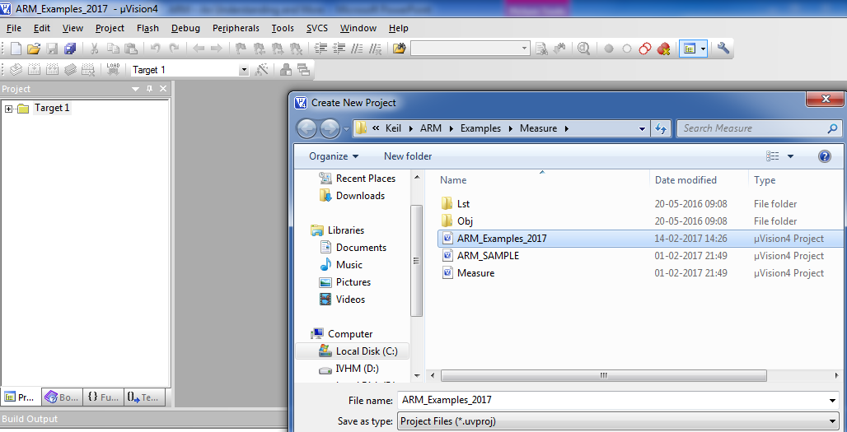
How to use Keil?

Slide 15
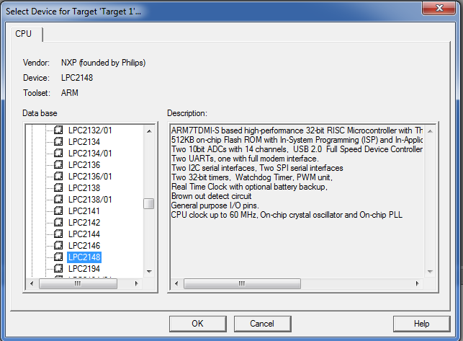
Select NXP – Philips – LPC2148

Slide 16
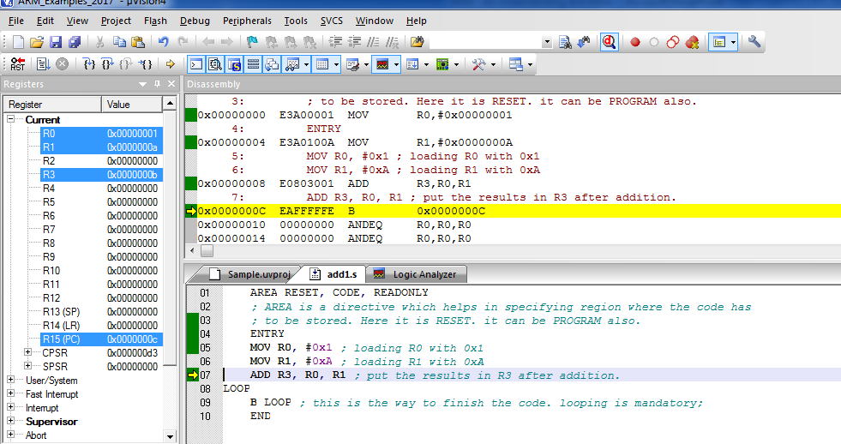
Simple addition with ARM mode instruction

Slide 17
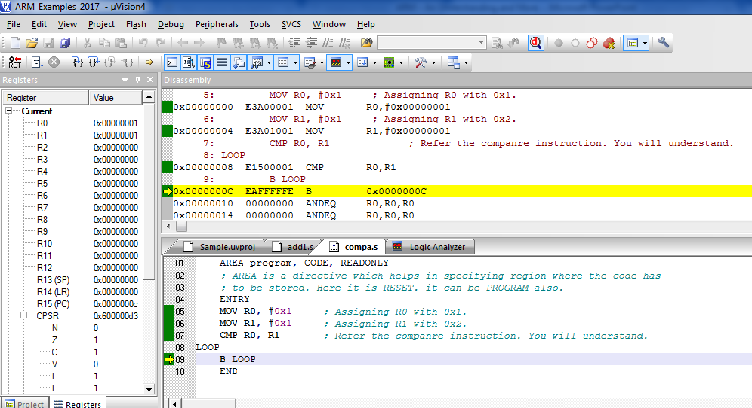
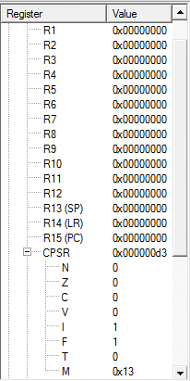
Compare Using ARM Instruction
SWI &11 can be
Used instead of
loop

Slide 18
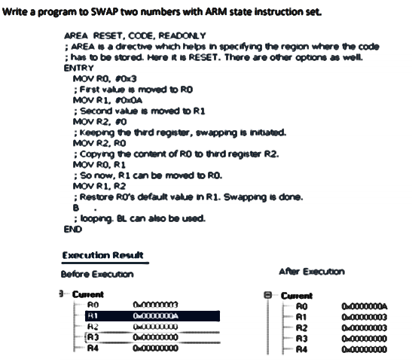
Swapping two numbers with ARM.

Slide 19
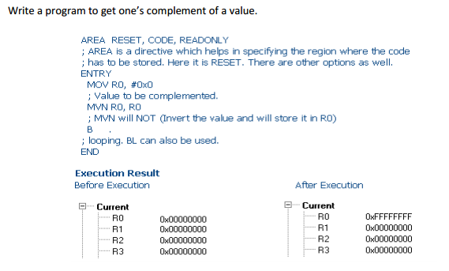
One’s complement

Slide 20
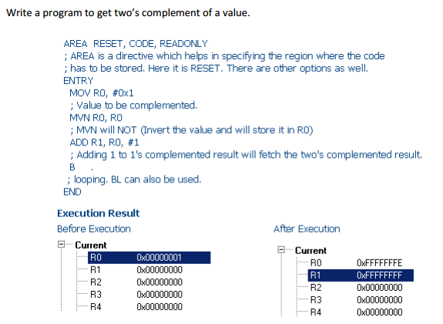
Two’s complement

Slide 21
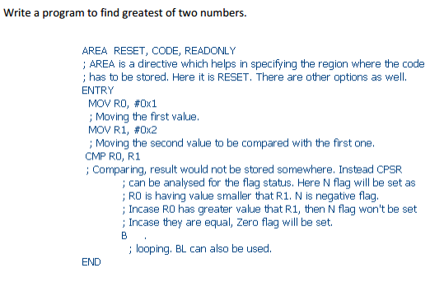
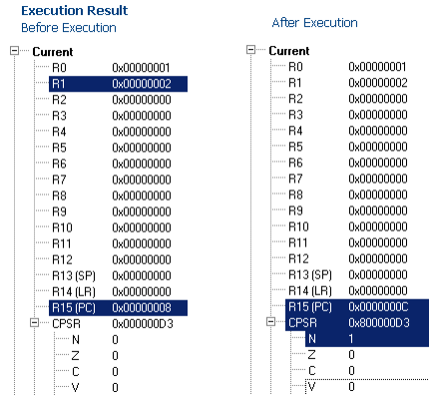
Greatest of 2 numbers

Slide 22

16 bit operation in ARM
; 16 bit data transfer happens here.
TTL 16bitdatatransfer
AREA program, CODE, READONLY
; AREA is a directive which helps in specifying region where the code has
; to be stored. Here it is RESET. it can be PROGRAM also.
ENTRY
Main
LDRB R1, Value ; Loading the value to be moved.
STR R1, Result ; Store it back.
SWI &11 ; Software Interrupt instead of loop option seen earlier.
Value DCW &C123
ALIGN ; This will support 16 bit execution in ARM mode.
Result DCW 0 ; Storage
END

Slide 23
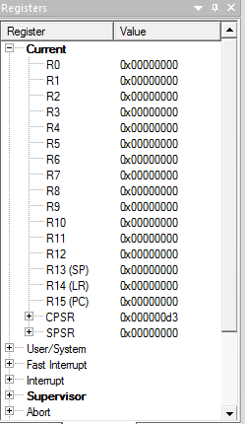
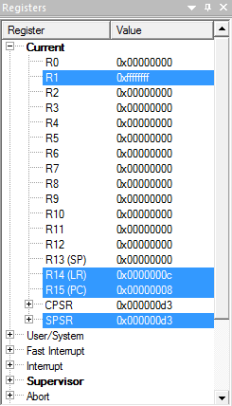
A Simple One’s complement in a different way.
; Ones complement Example.
TTL onescomplement
AREA program, CODE, READONLY
; AREA is a directive which helps in specifying region where the code has
; to be stored. Here it is RESET. it can be PROGRAM also.
ENTRY
Main
LDRB R1, Value ; Loading the value to be complemented.
MVN R1, R1 ; See the way I used R1 and R1. MVN is NOT.
SWI &11 ; Software Interrupt instead of loop option seen earlier.
Value DCW &0000
ALIGN ; This will support 16 bit execution in ARM mode.
END
Before Execution
After Execution

Slide 24
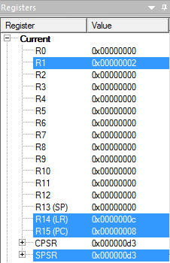
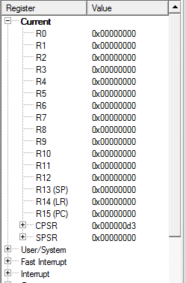
Shift Left One Bit.
; Shift Left One Bit!
TTL shift left one bit
AREA RESET, CODE, READONLY
; AREA is a directive which helps in specifying region where the code
; has to be stored. Here it is RESET. it can be PROGRAM also.
ENTRY
Main
LDRB R1, Value ; Loading the value to be complemented.
MOV R1, R1, LSL#0X1 ; one bit shift.
SWI &11
Value DCD &0001
END
Before Execution
After Execution

Slide 25
Getting into Thumb Mode. (No great change, it is a mode, that’s all! )
Core has two execution states ARM and Thumb;
Thumb is a compressed and 16 bit representation of a subset of the ARM instruction set.
Like ARM, Thumb also uses load store architecture for data processing, data transfer and control flow instructions.
The standard chip that includes the Thumb instruction set is the ARM7TDMI where "T" specifies Thumb. (Remember this, we saw this in CPSR ;))

Slide 26
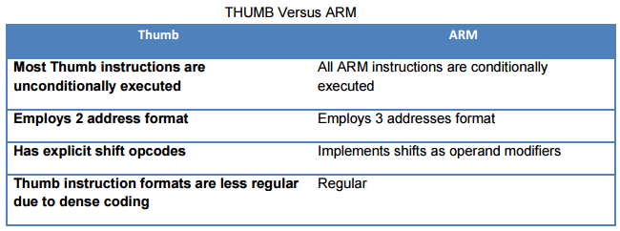
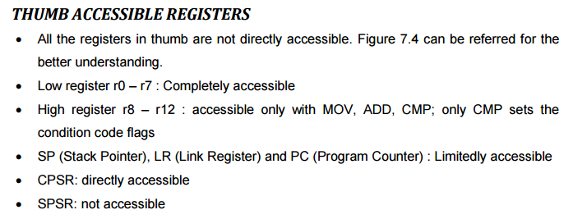
Contd.,

Slide 27
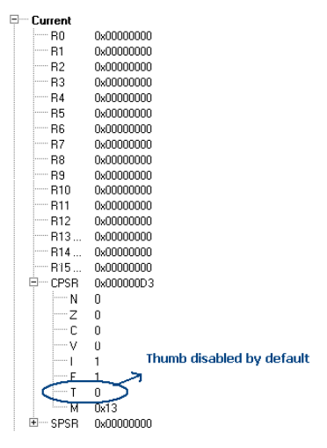
How to set thumb state?
D3 is the default value for the CPSR as shown in the below. So by default one can observe that the Thumb state is disabled. To get it enabled, as already discussed CPSR should be accessed and T bit should be set.

Slide 28
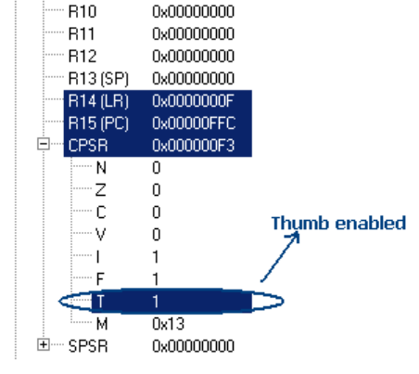
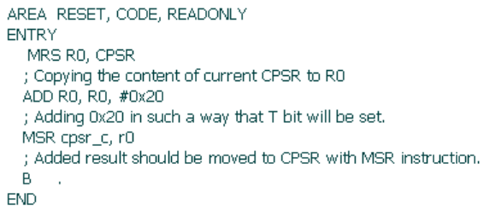
Contd.,
Setting the T bit can be done by adding 0x20 to the D3. It will then set the T bit and eventually the THUMB mode will be set

Slide 29
THANK YOU
SHRIRAM K VASUDEVAN

